Slide 1
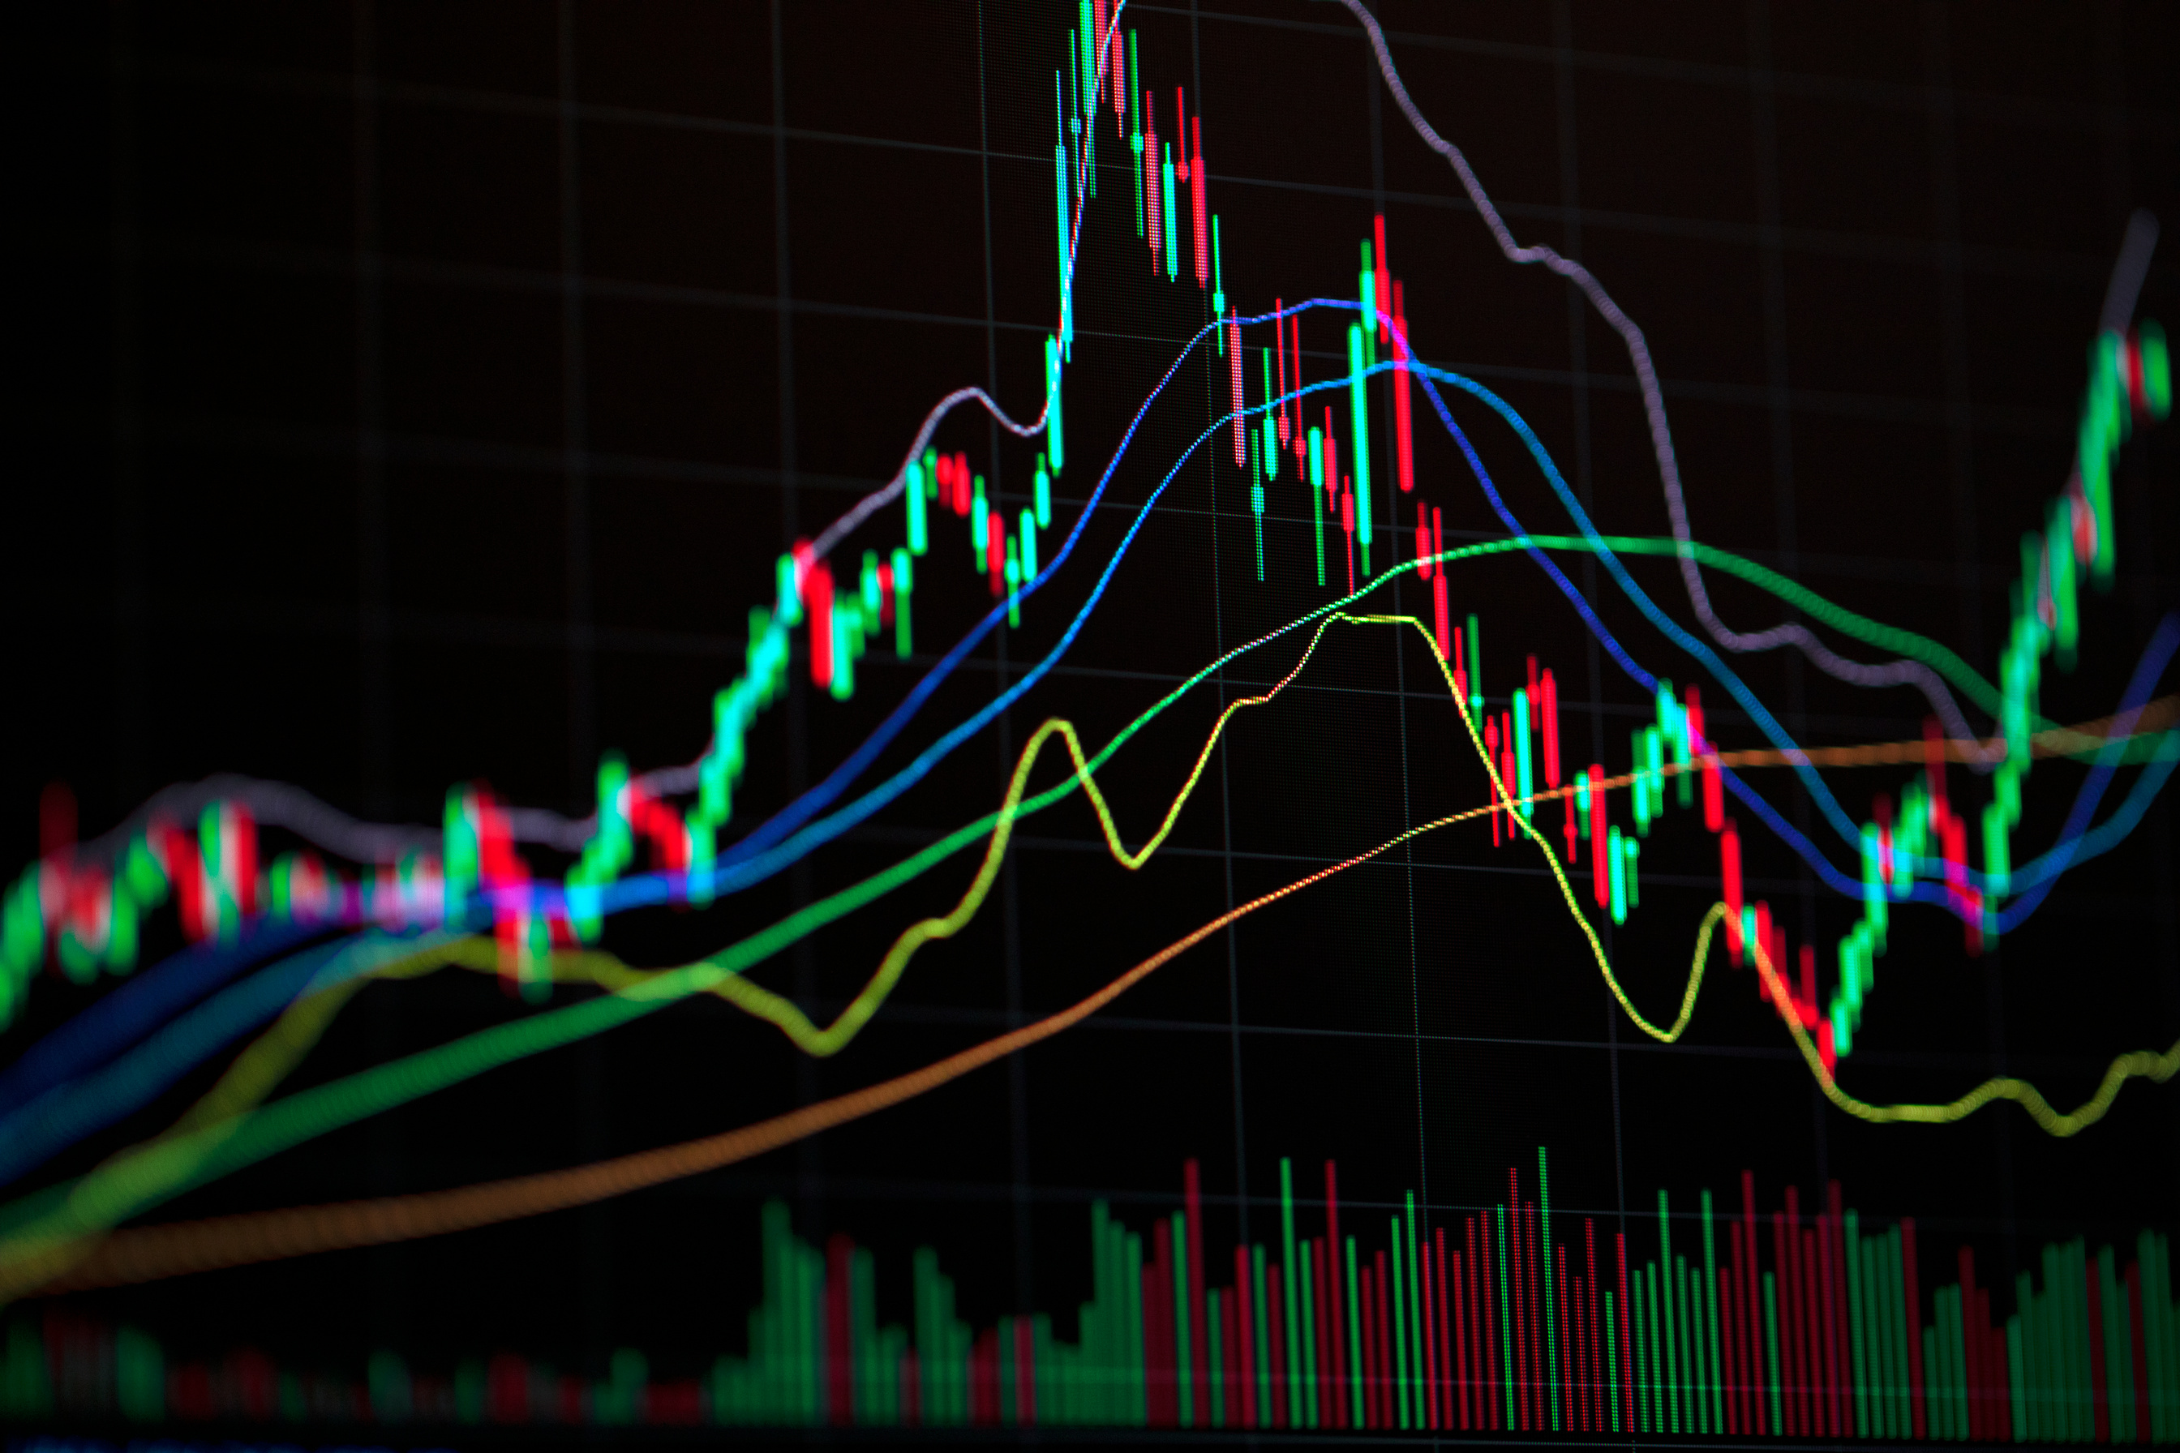
Playing against S&P 500
Project about investing in Stocks of the S&P 500 Index
Mid-Project by Jan Gfeller

Slide 2
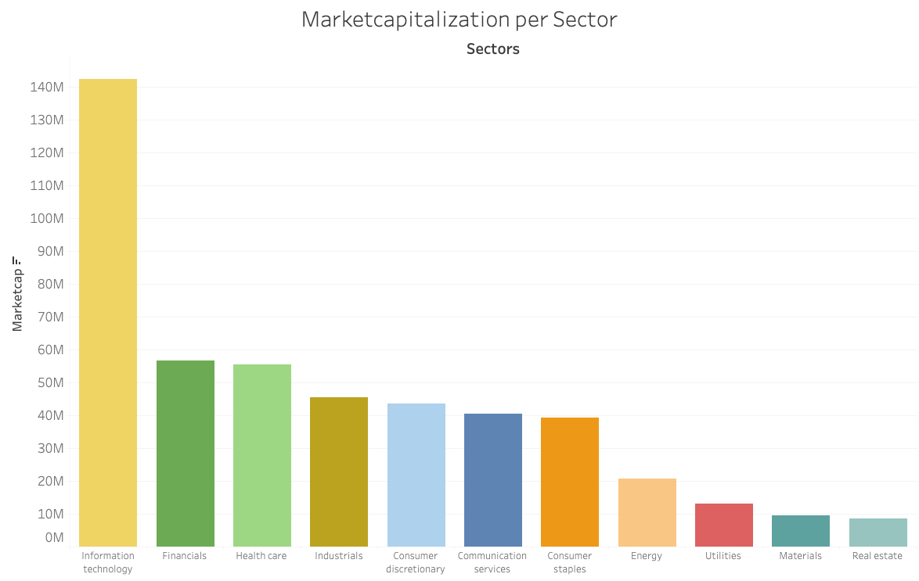
About S&P 500 Index
11 Sectors
126 Subsectors
500 of largest U.S. companies
Index for overall market
Notes:
important for overall market sentiment

Slide 3

Dataset
Dataset from Kaggle
Over 4000 Assets
consisting of single .csv files
Original Columns:
Date
Company
Prices (open, close, high, low)
Volume
Dividends
Stock Splits
Notes:
Dataset from Kaggle

Slide 4
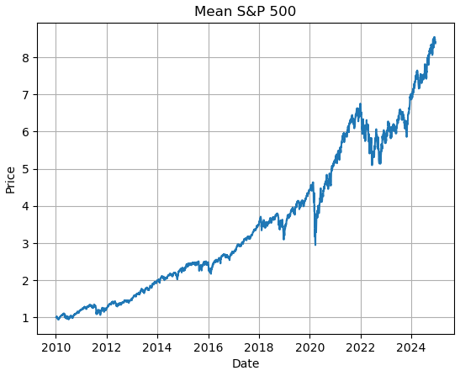
Exploratory Data Analysis
Statistics:
4 Mio. rows
Starting 1960
1 Entry per day/Stock
Notes:
to test data
short analysis:
normalized price data
average of all s&p 500 stocks:
8.5 x since 2010
long term investing seems to pay out
2022: large dip because of war in ukraine

Slide 5
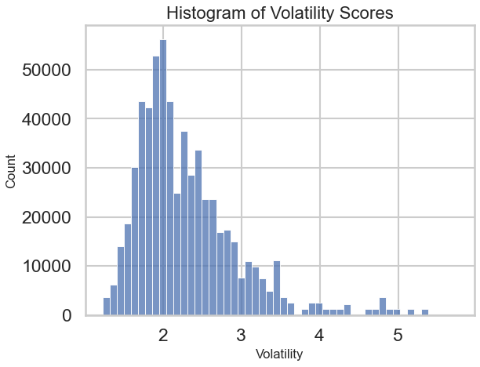
Inferential Statistics
Null Hypothesis:
No difference in volatility over different sectors
Alternative Hypothesis:
There is a difference in volatility visible
Notes:
regarding volatility:
day to day volatility
--> per stock:
price change =
percentual difference to day before
standard deviation
aggregated sectors

Slide 6
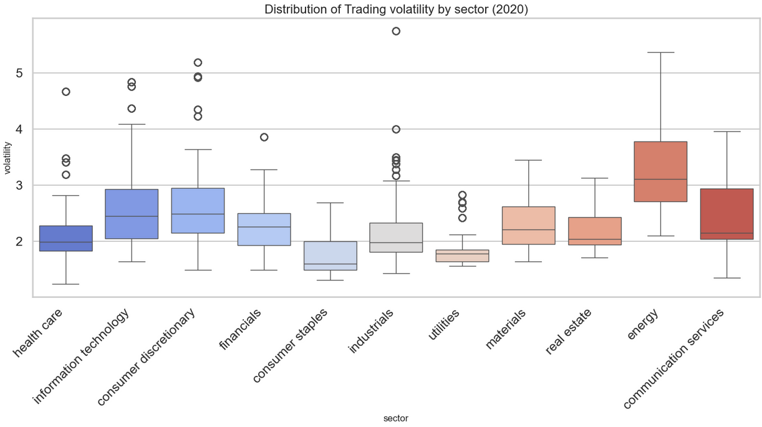
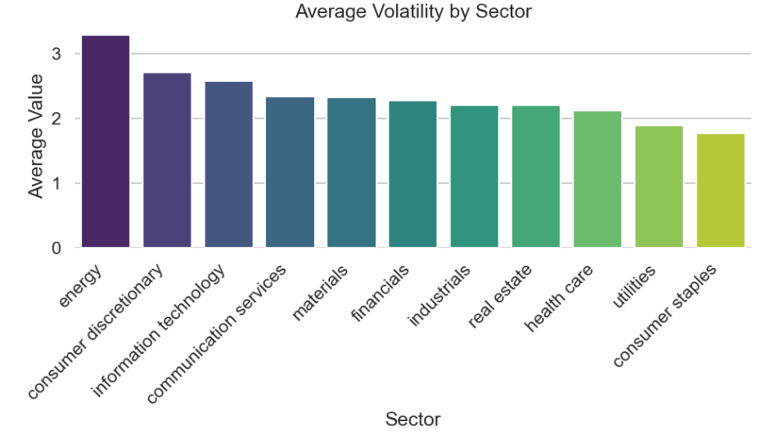
Inferential Statistics
p-Value = 1.4 * e-22
Notes:
very low p-value
--> we clearly reject null hypothesis
energy has high median and overall
on the other side:
consumer staples, utilities
--> lower volatility values
right side:
ranked from high to low volatility
significant difference

Slide 7
Feature Engineering
Original Columns:
Date
Company
Prices (open, close, high, low)
Volume
Dividends
Stock Splits
Web Scraping:
Marketcap
Sector
Subsector
Feature Engineering:
Norm Price
Price Change
Volatility
Averages (MA & EMA)
Bollinger Bands
RSI
MACD
Notes:
preparation for machine learning
used some of the original features,
added some using webscraping,
added with feature engineering
already talk about:
norm price
price change
volatility
added financial indicators:
moving averages
also exponential
bollinger bands:
standard deviation x2
RSI:
relative strength index
indicates overbought / oversold conditions
not in the same scale as price data
MACD:
Moving Average Convergence/Divergence
another important trading indicator

Slide 8

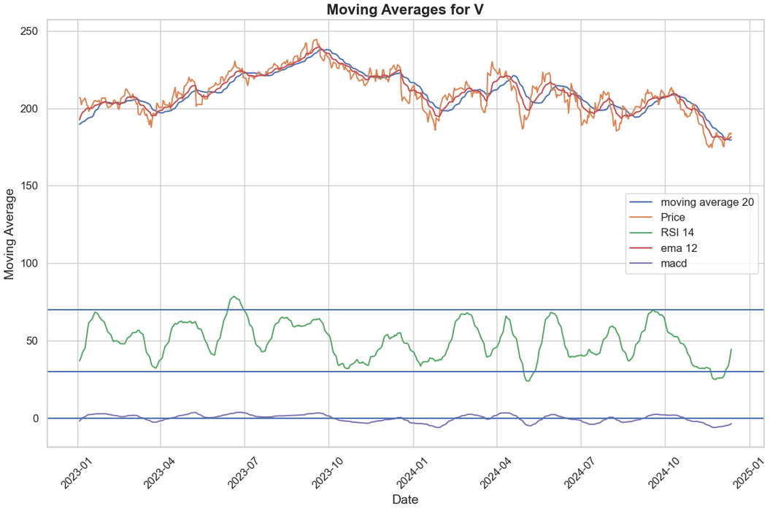
Feature Engineering
Original Columns:
Date
Company
Prices (open, close, high, low)
Volume
Dividends
Stock Splits
Web Scraping:
Marketcap
Sector
Subsector
Feature Engineering:
Norm Price
Price Change
Volatility
Averages (MA 20 & 60)
Bollinger Bands
RSI
MACD
Notes:
example price data for one stock

Slide 9

XG Boost
Training Data: 1960 - 2021
Preprocessing
lagged features
drop categoricals
default settings
Metrics: Profit on Portfolio
2022: -25%
2023: +53%
2024: +36%
Test:
2022 - 2024
Notes:
start machine learning with xg boost
- works well with large datasets
- does not care about outliers too much
- already know some of the parameters from previous experience
lagged features:
technical indicators
--> shifted for 1, 2, ... days
metrics: profit on virtual portfolio: invested in 10 top predicted profit stocks
non tuned model
already good numbers
want to make use of the categorical features
categoricals:
0ne-hot encoding: over 600 new features
--> way too much
integer encoding: implies an order but there is no order
researched opportunities
neural networks are great with this kind of categorical data

Slide 10

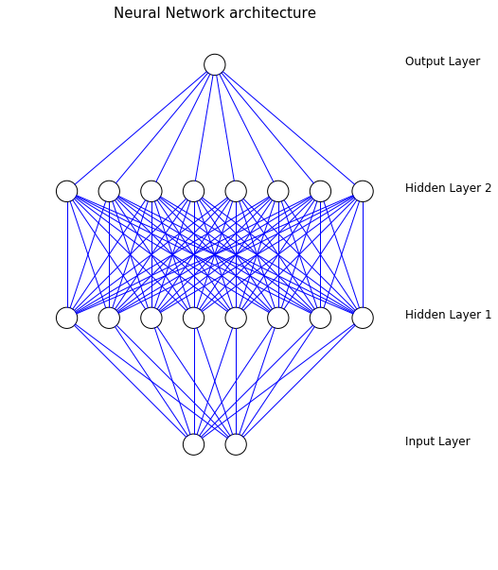
Keras
High level Python library
Built on top of Tensorflow
Components:
Embedding, Flatten: used for Input Categoricals
Dense: Basic Building Block
Optimizer: Adam
Notes:
tensor flow:
deep learning framework
logic behind deep learning model: different layers:
- input layer: every categorical feature needs own layer
embedding + flatten
- hidden layers: where the magic happens
dense layers (basic building blocks), lstm (long short term memory) for time series predictions
- output layer for predictions
adam:
optimizer
Adaptive Moment Estimation
adjusts the weights while training,
not include in further steps of project, focus on xg boost model

Slide 11
Streamlit

Slide 12


To do:
Code:
Restructure, Clean Up,
Implement best practices
XG Boost:
Refine, Grid Search
Keras:
Fix, Refine
Streamlit:
Enhance,
Add second Risk profile
Notes:
keras
not sure if it works entirely as it should
--> potential
second risk profile
top predicted profits
prefer more steady growth, a bit safer

Slide 13


Thank you!

